Slide 1
COMP 3400
Week 8 - Wednesday

Slide 2
Last time
What did we talk about last time?
Internet
P2P architectures
Transport layer:
UDP details

Slide 3
Questions?

Slide 4
Project 2

Slide 5
Transport Layer

Slide 6
TCP
Reliable transport is often desirable, so Transmission Control Protocol (TCP) is usually used for that purpose
Unlike UDP, TCP creates a session with multiple messages sent back and forth between the two hosts
Messages are numbered
TCP also uses flow control, allowing hosts to avoid sending more data at once than their receivers can handle

Slide 7
TCP segments
Because they have to do more, TCP segments contain more information:
Source port
Destination port
Sequence number (SEQ)
Acknowledgement number (ACK)
Flags
Receive window
Checksum
Urgent data pointer
Optional fields
Payload (actual data)
Like UDP, most of these fields are 16 bits
SEQ and ACK are 32 bits
Optional fields vary
Payload is however long it needs to be

Slide 8
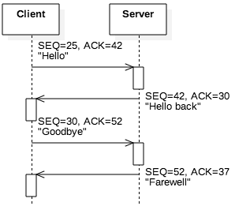
Numbering
So that segments aren't lost, hosts send a sequence number (SEQ) with each segment
The initial value is a random number k
After sending n bytes, the next SEQ will be n + k
So that the A knows how much B has gotten, B's next response to A contains an acknowledgement number (ACK) which is the last SEQ from A plus the size of that message
In this way, both sides know how much the other side is sending, what's lost, and what's received
If nothing is lost and messages are going back and forth, each SEQ will be the last ACK received

Slide 9
Flow control
Buffers are always finite
A TCP connection has a buffer that's reading information as it arrives from the other host
Data is removed from this buffer as the process reads it from the socket
If too much data is arriving, the buffer fills up, and data will be lost
Each time a process sends a TCP segment, it also sends a receive window value, giving the number of bytes available in the buffer for that connection
If there's not enough space for the next message, the sender will break its message into parts so that the part it sends will fit into the receive window

Slide 10
Example TCP segment
The following is a TCP segment for an HTTP GET request
Header | 1388 0050 0000 0017 0000 002a 5010 1000 cf33 0000 | source port = 5000 (0x1388) destination port = 80 (0x0050) sequence number = 23 (0x17) acknowledgement number = 42 (0x2a) flags receive window = 4096 (0x1000) checksum urgent data ptr
Payload | 4745 5420 2f20 4854 5450 2f31 2e31 0d0a 486f 7374 3a20 6578 616d 706c 652e 636f 6d0d 0a43 6f6e 6e65 6374 696f 6e3a 2063 6c6f 7365 0d0a 0d0a | GET / HTTP/1 .1\r\nHost: ex ample.com\r\nC onnection: c lose\r\n\r\n

Slide 11
Flags
The TCP header has a 16-bit flags field that can signal different information about a segment
The book mentions six of these:
URG: Urgent pointer field is significant
ACK: Acknowledgment field is significant
PSH: Push buffered data to the receiving applications
RST: Reset the connection
SYN: Synchronize sequence numbers (set only in the first segment)
FIN: Last segment from sender
Index | 0-3 |  |  |  | 4-9 |  |  |  |  |  | 10-15
Meaning | Length of header in 32-bit words |  |  |  | Not explained here |  |  |  |  |  | U R G | A C K | P S H | R S T | S Y N | F I N
Value | 0 | 1 | 0 | 1 | 0 | 0 | 0 | 0 | 0 | 0 | 0 | 0 | 0 | 0 | 0 | 0
Hex | 5 |  |  |  | 0 |  |  |  | 0 |  |  |  | 0

Slide 12
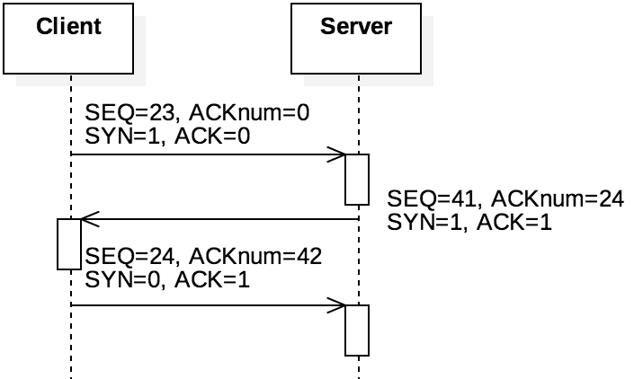
TCP handshake
When a TCP connection is being established by a client calling connect(), three segments are sent:
SYN (from the client)
SYN-ACK (from the server)
ACK (from the client)
These segments are called the three-way handshake
They are normal segments except that they have no data
The SYN bit is set on the SYN and SYN-ACK segments, and the ACK bit is set on the ACK segment
ACK is set on any segment intended to show that an earlier segment is being acknowledged

Slide 13
TCP handshake example
SYN Request (client to server) | 1388 0050 0000 136d 0000 0000 5002 1000 2e67 0000 | source port = 5000 (0x1388) destination port = 80 (0x0050) sequence number = 4973 (0x136d) acknowledgement number = 0 flags = SYN receive window = 4096 (0x1000) checksum urgent data ptr
SYN-ACK Response (server to client) | 0050 1388 0000 0273 0000 136e 5012 1000 2be3 0000 | source port = 80 (0x0050) destination port = 5000 (0x1388) sequence number = 627 (0x273) acknowledgement number = 4973 (0x136d) flags = SYN and ACK receive window = 4096 (0x1000) checksum urgent data ptr
ACK Response (client to server) | 1388 0050 0000 136e 0000 0274 5010 1000 2bf6 0000 | source port = 5000 (0x1388) destination port = 80 (0x0050) sequence number = 4974 (0x136d) acknowledgement number = 628 (0x274) flags = ACK receive window = 4096 (0x1000) checksum urgent data ptr

Slide 14
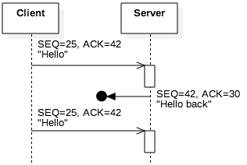
Packet loss
Using SEQ and ACK numbers with the checksum allows for error detection
It's hard to be sure what went wrong, but some conclusions can be drawn:
Incorrect ACK: If the ACK is too small, the sender of the ACK missed one or more messages
Incorrect SEQ: If the SEQ is larger than expected, the receiver of the SEQ missed one or more messages
Incorrect checksum: The segment is corrupted or part is missing
In all three cases, sending the last segment based on acknowledged data is a request for the other side to resend

Slide 15
Timeouts
To make robust guarantees about message delivery, TCP also keeps track of the time it takes for segments to make a trip
If a segment is missing for long enough, TCP can request it again
How long should it wait?
Because the Internet is a large and heterogeneous place, it wouldn't make sense to wait for any particular fixed time
Instead, the retransmission timeout (RTO) is computed based on previous transmission times and how much they fluctuate

Slide 16
RTT and SRTT
Round-trip time (RTT) is the amount of time it takes to for a segment to be sent to another host and then receive a reply
RTT can change for each segment
To estimate how long the next RTT is likely to be, TCP uses a smoothed round-trip time (SRTT), which is a weighted average of the old SRTT and the latest RTT
The new RTT is often weighted with $\frac{1}{8}$, but other values are possible
$SRTT^{′}= \frac{7}{8}SRTT+\frac{1}{8}RTT$
Larger values would weight the most recent exchange heavier against history
Using another weighted average, TCP keeps track of the variance of the RTT
A final formula uses the expected RTT (the SRTT) and this variance to compute the current RTO

Slide 17
Network Security

Slide 18
CIA
Confidentiality
Integrity
Availability
Network security is built on principles from general computer security:
Confidentiality
Integrity
Availability

Slide 19
Confidentiality
You don't want other people to be able to read your stuff
Some of your stuff, anyway
Cryptography, the art of encoding information so that it is only readable by those knowing a secret (key or password), is a principle tool used here
Confidentiality is also called secrecy or privacy

Slide 20
Integrity
You don't want people to change your stuff
You want to know:
That your important data cannot be easily changed
That outside data you consider trustworthy cannot be easily changed either
There are many different ways that data can be messed up, and every application has different priorities

Slide 21
Availability
You want to be able to use your stuff
Many attacks are based on denial of service, simply stopping a system from functioning correctly
A SYN flood where attackers try constantly to create TCP connections from spoofed IP addresses is a classic DoS attack
Availability can mean any of the following:
The service is present in usable form
There is enough capacity for authorized users
The service is making reasonable progress
The service completes in an acceptable period of time

Slide 22
Ticket Out the Door

Slide 23
Upcoming

Slide 24
Next time…
Finish network security
Internet layer
Link layer
Wireless

Slide 25
Reminders
Finish Project 2
Due Friday by midnight!
Read sections 5.6, 5.7, and 5.8

